Slide 1

Automate Excel 101
openpyxl.readthedocs.io/

Slide 2
Openpyxl
Create an Excel file
Load an existing file
Copy data from one sheet to another
Create chart
https://openpyxl.readthedocs.io/en/stable/

Slide 3
Create an Excel file
from openpyxl import Workbook
wb = Workbook()
# grab the active worksheet
ws = wb.active
# Data can be assigned directly to cells
ws['A1'] = 42
# Rows can also be appended
ws.append([1, 2, 3])
# Save the file
wb.save("sample.xlsx")

Slide 4
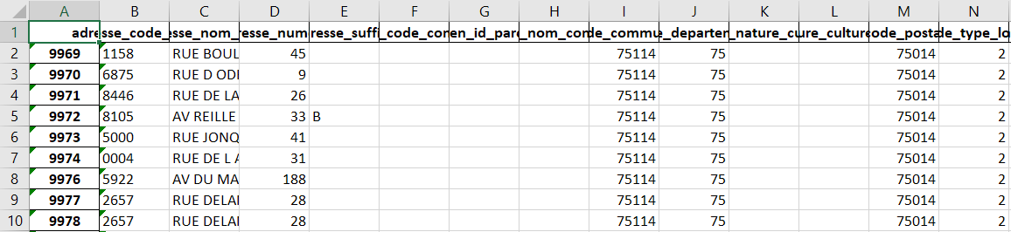
Load an existing file
workbook = xl.load_workbook('dvf14_chart.xlsx') sheet_1 = workbook['Sheet1’]
workbook.create_sheet('Sheet2’)
Workbook.sheetnames
sheet_2 = workbook['Sheet2']

Slide 5
Copy data from one sheet to another
AL = 38
mr = sheet_1.max_row
for i in range (1, mr + 1):
# reading cell value from source excel file
c = sheet_1.cell(row = i, column = AL)
# writing the read value to destination excel file
sheet_2.cell(row = i, column = 1).value = c.value
https://www.geeksforgeeks.org/python-how-to-copy-data-from-one-excel-sheet-to-another/

Slide 6
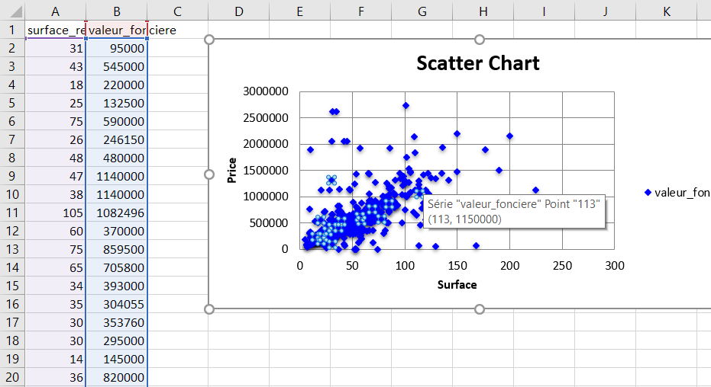
Scatter Chart
chart = ScatterChart()
xvalues = Reference(sheet_2, min_col = 1, min_row = 2, max_row = sheet_1.max_row)
values = Reference(sheet_2, min_col=2, min_row=1, max_row=mr)
series = Series(values, xvalues,title_from_data=True)
sheet_2.add_chart(chart, "D2")

Slide 7
Chart style
chart.title = "Scatter Chart"
chart.style = 13
chart.y_axis.title = 'Price'
chart.x_axis.title = 'Surface'

Slide 8
Series style
series.marker.symbol = "diamond"
series.marker.graphicalProperties.solidFill = "0000FF" # Marker filling
series.marker.graphicalProperties.line.solidFill = "0000FF" # Marker outline
series.graphicalProperties.line.noFill = True # hide lines
chart.series.append(series)

